Slide 1
Team Compaction
강상우
E-Mail : aarom416@naver.com
발표: 좌우꾸와쒼 E-Mail : erosbryant@dankook.ac.kr

Slide 2
Contents
TwoLevelIterator
MergingIterator

Slide 3
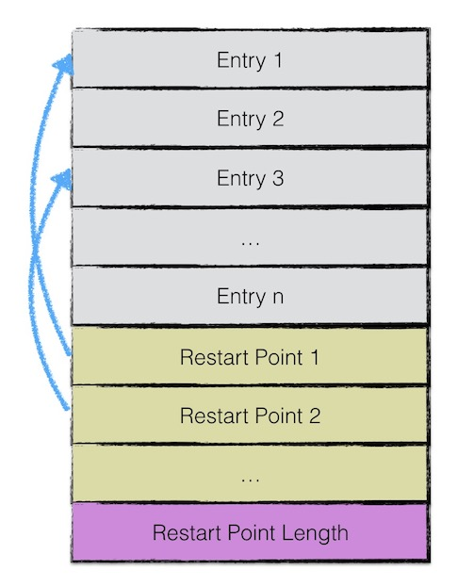
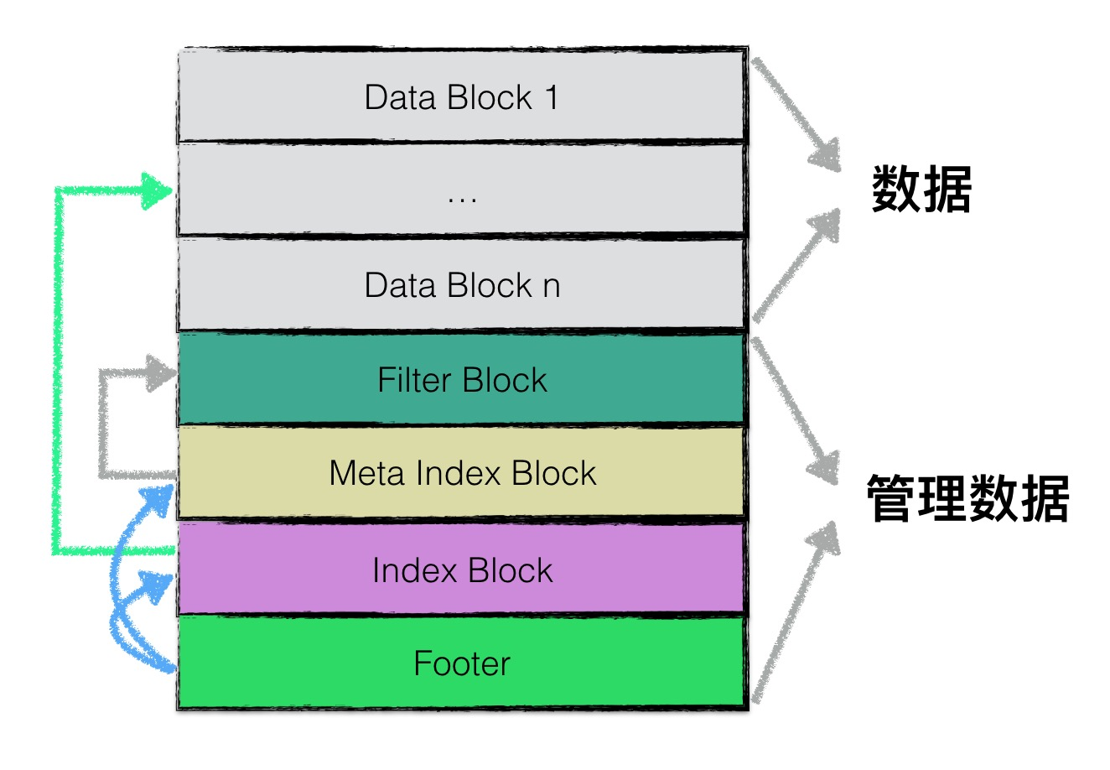
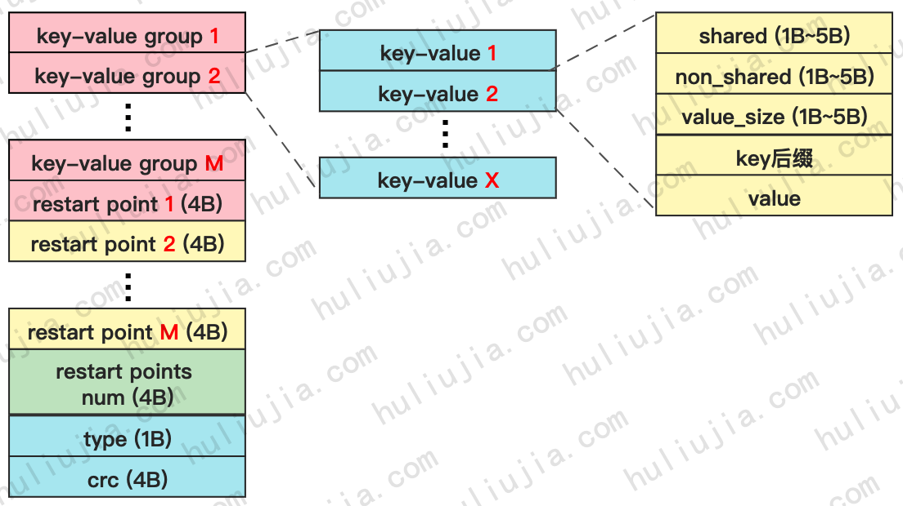
TwoLevelIterator
Using in the SST
https://leveldb-handbook.readthedocs.io/zh/latest/sstable.html
https://leveldb-handbook.readthedocs.io/zh/latest/sstable.html

Slide 4
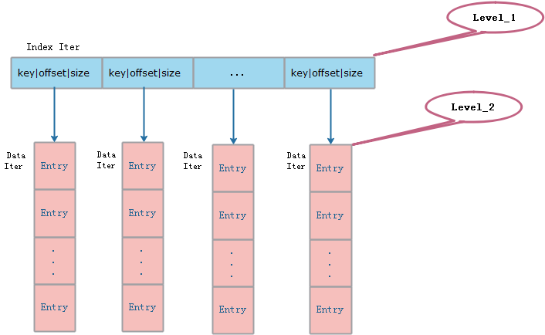
TwoLevelIterator
index block
index_iter
data block
data_iter
data
https://img-blog.csdnimg.cn/20200614175126109.png#pic_center?x-oss-process=image/watermark,type_ZmFuZ3poZW5naGVpdGk,shadow_10,text_aHR0cHM6Ly9ibG9nLmNzZG4ubmV0L0g1MTQ0MzQ0ODU=,size_16,color_FFFFFF,t_70

Slide 5

TwoLevelIterator
Iterator class 상속
SST의 경우:
index_iter는 index block을 가리키는 iter
2. block_function은 Table::BlockReader, 즉 블록을 읽는 것
arg는 SST을 가리키는 것
4. Options 읽기 옵션

Slide 6
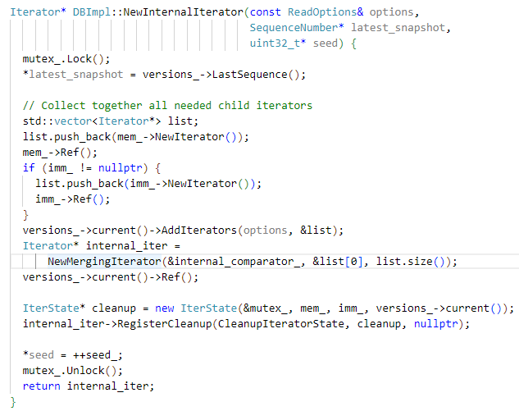
MergingIterator
MergingIterator
이름 대로 Iterator들을 merge
NewInternalIterator
핵심 함수

Slide 7
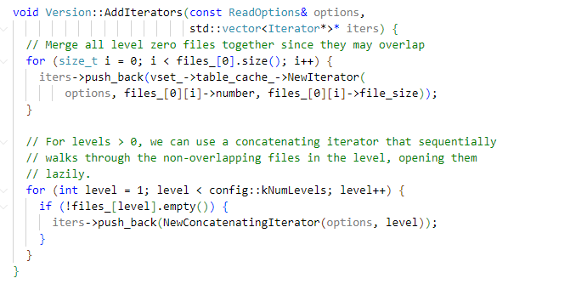
MergingIterator
Vector<iterator*>
Memtable
Imm Memtable
level 0
level 1 ~ N

Slide 8
MergingIterator
Vector<iterator*>
Memtable
Imm Memtable
level 0
level 1 ~ N

Slide 9
MergingIterator
MergingIterator
이름 대로 Iterator들을 merge
NewInternalIterator
핵심 함수

Slide 10
Iterator 기능적 흐름도
DBiter
leveldb
Iterator
MergingIterator
Memtable Iterator
level0TwoLevelIterator
Level 1 ~ NTwoLevelIterator
Imm Iterator
index iterator
Data iterator
Version
LevelFileNumIterator
TwoLevelIterator
index iterator
Data iterator
https://www.jianshu.com/p/9e63dea36af0

Slide 11
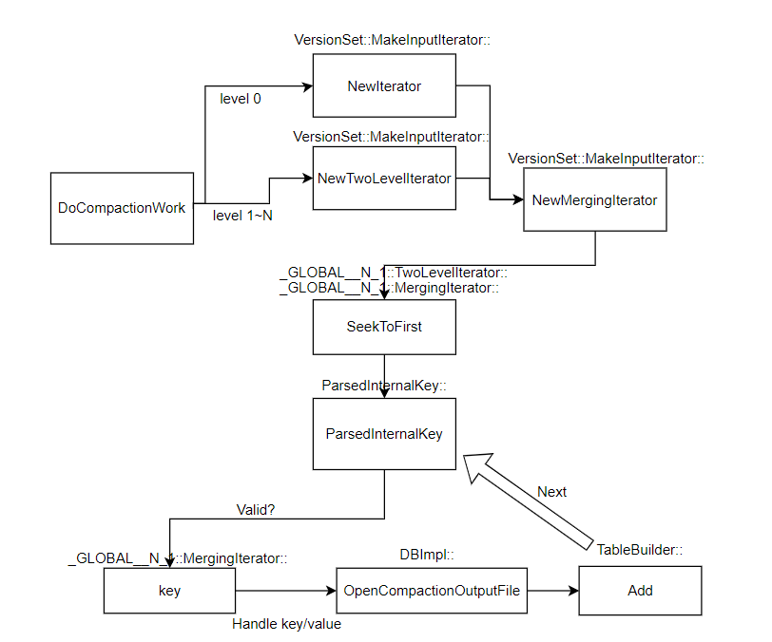
DoCompactionWork

Slide 12
Thank you

